Slide 1
GIT Hooks

Slide 2
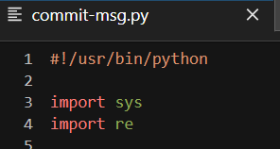

What are Git Hooks?
Git hooks are scripts that run automatically every time a particular event occurs in a Git repository. They let you customize Git’s internal behavior and trigger customizable actions at key points in the development life cycle.
Types of Git Hooks :
Client-side hooks
Server side hooks
Common use cases for Git hooks include :
Encouraging a commit policy
Altering the project environment depending on the state of the repository
Implementing continuous integration workflows
You can write these programs in any programming language (Ex : Bash, Python,Ruby etc.) as long as we put the shebang line at the beginning of each program

Slide 3
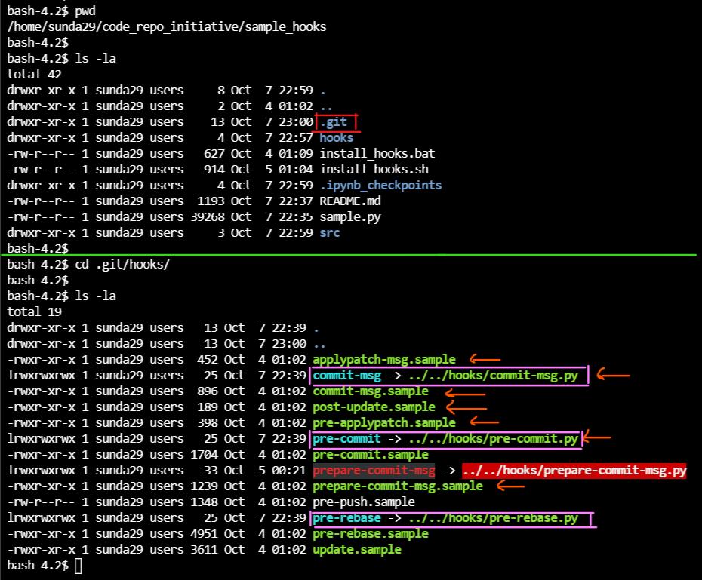
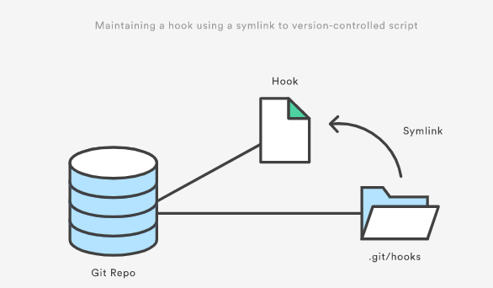
Installing Git Hooks
Place Hook programs inside the git repo
Create Symbolic links between programs outside git repo to those within .git/hooks directory (View the pink boxes on the first pic)
Hooks reside in the .git/hooks directory of every Git repository
Need to remove .sample at the end and provide EXECUTE permissions (chmod +x filename) for Git hooks to be installed and executable
Notes:
https://www.computerhope.com/unix/uln.htm

Slide 4
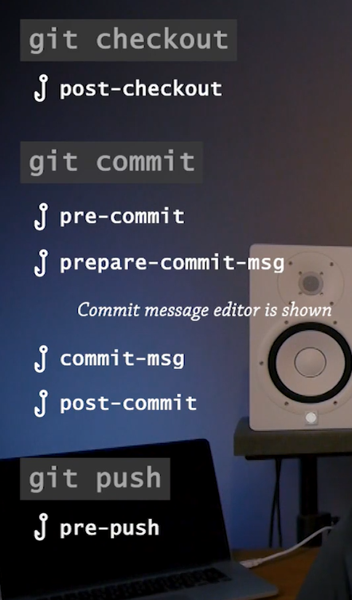
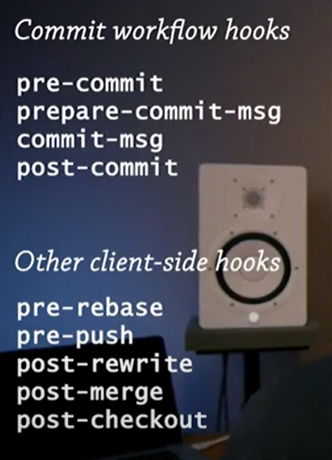
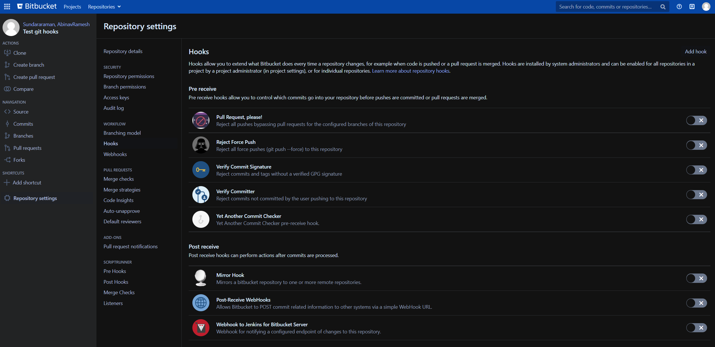
Types of Git Hooks
Client side hooks
Server side hooks
You can view Server side hooks as an admin of the project

Slide 5
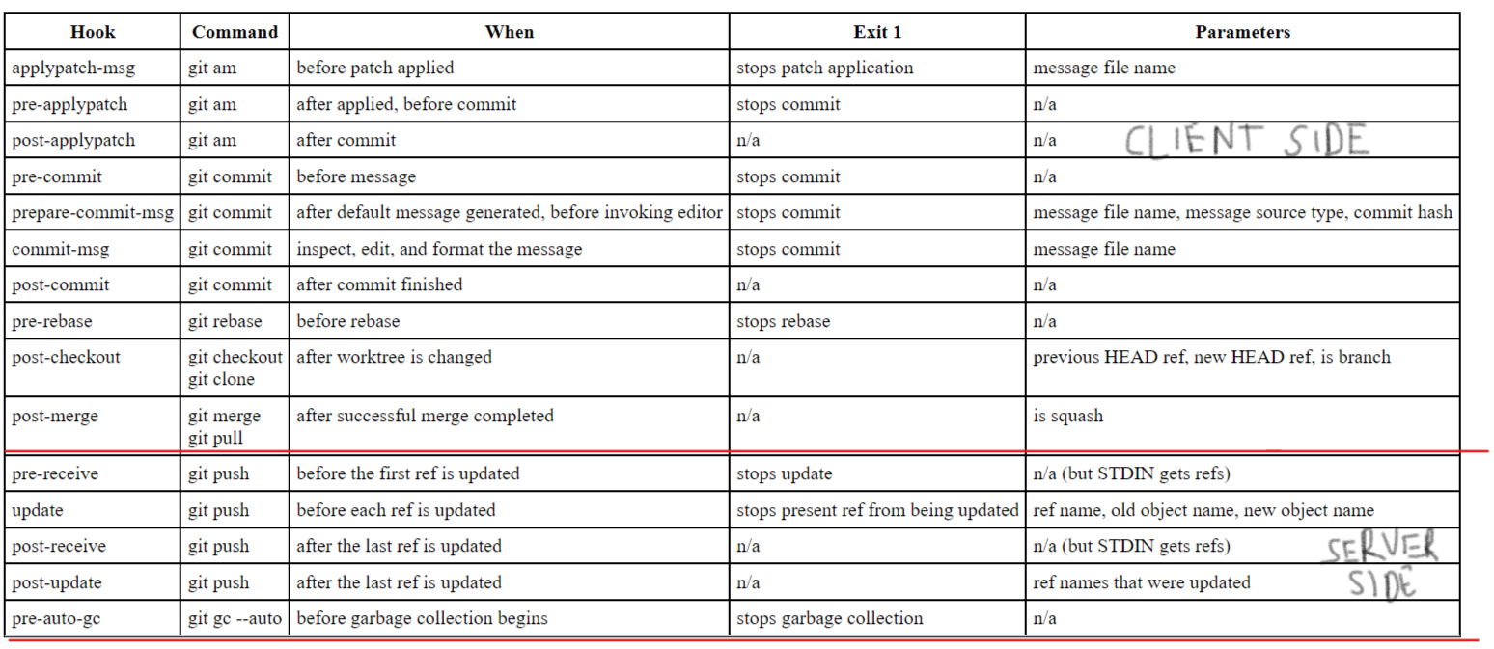
Types of Git Hooks - Explanation
Notes:
https://www.analysisandsolutions.com/code/git-hooks-summary-cheat-sheet.htm

Slide 6
Use cases of Git Hooks – Commit Workflow hooks
Commit workflow hooks :
pre-commit
Linting/Static code analysis
Spell checking
Codestyle (Enforce PEP-8 standards)
Prepare-commit-msg
To alter the commit message/ give a completely new commit message
We can include ticket id, branch name, style checklist, rules for commits
Commit-msg
to check that your commit message is conformant to a required pattern.
Post-commit
We can use it for notifications to team members via slack, teams
Notes:
https://git-scm.com/book/en/v2/Customizing-Git-Git-Hooks

Slide 7
Use cases of Git Hooks – Other Client side hooks
Other client side hooks :
pre-rebase
You can use this hook to disallow rebasing any commits that have already been pushed.
Pre-push
You can use it to validate a set of ref updates before a push occurs (a non-zero exit code will abort the push).
Post-rewrite : This hook has many of the same uses as the post-checkout and post-merge hooks.
Post-merge
You can use it to restore data in the working tree that Git can’t track, such as permissions data.
This hook can likewise validate the presence of files external to Git control that you may want copied in when the working tree changes.
Post-checkout
You can use it to set up your working directory properly for your project environment. This may mean moving in large binary files that you don’t want source controlled, auto-generating documentation, or something along those lines.
E-mail workflow hooks (Only if you use git –am command)
applypatch-msg
pre-applypatch
post-applypatch
Notes:
https://git-scm.com/book/en/v2/Customizing-Git-Git-Hooks

Slide 8
Use cases of Git Hooks – Server side hooks
Server side hooks :
pre-receive
make sure none of the updated references are non-fast-forwards, or to do access control for all the refs and files they’re modifying with the push.
update : The update script is very similar to the pre-receive script, except that it’s run once for each branch the pusher is trying to
Post-receive
can be used to update other services or notify users
emailing a list, notifying a continuous integration server, or updating a ticket-tracking system – you can even parse the commit messages to see if any tickets need to be opened, modified, or closed.
Notes:
https://git-scm.com/book/en/v2/Customizing-Git-Git-Hooks

Slide 9
Example
Sample GIT project implementing hooks

Slide 10
Thank you!

